Slide 1
IMAGE REPRESENTATION AND PRE PROCESSING

Slide 2
Pixel Value | Pixel // 64
0 | 0
20 | 0
50 | 0
63 | 0
64 | 1
80 | 1
100 | 1
127 | 1
128 | 2
150 | 2
191 | 2
192 | 3
220 | 3
255 | 3

Slide 3
0–63 → 0
64–127 → 1
128–191 → 2
192–255 → 3
So dividing by 64 puts every pixel into one of 4 groups.
256/4=64

Slide 4
Image Representation is the method of representing an image inside a computer so that it can be stored, processed, and analyzed.
In Computer Vision, images are represented digitally as a collection of pixels.

Slide 5
Image Representation is the process of converting a real-world (continuous) image into a digital image made up of pixels, where each pixel stores intensity or color information.
How an Image is Represented
Imagine a small grayscale image:
Columns
0 1 2 3
-----------------------
0 | 255 180 120 80
1 | 200 160 100 60
2 | 150 110 70 40
3 | 100 80 50 20

Slide 6
Each number is called a pixel intensity.
0 → Black
255 → White
Between 0 and 255 → Shades of gray
The computer stores this as a 2D matrix.

Slide 7
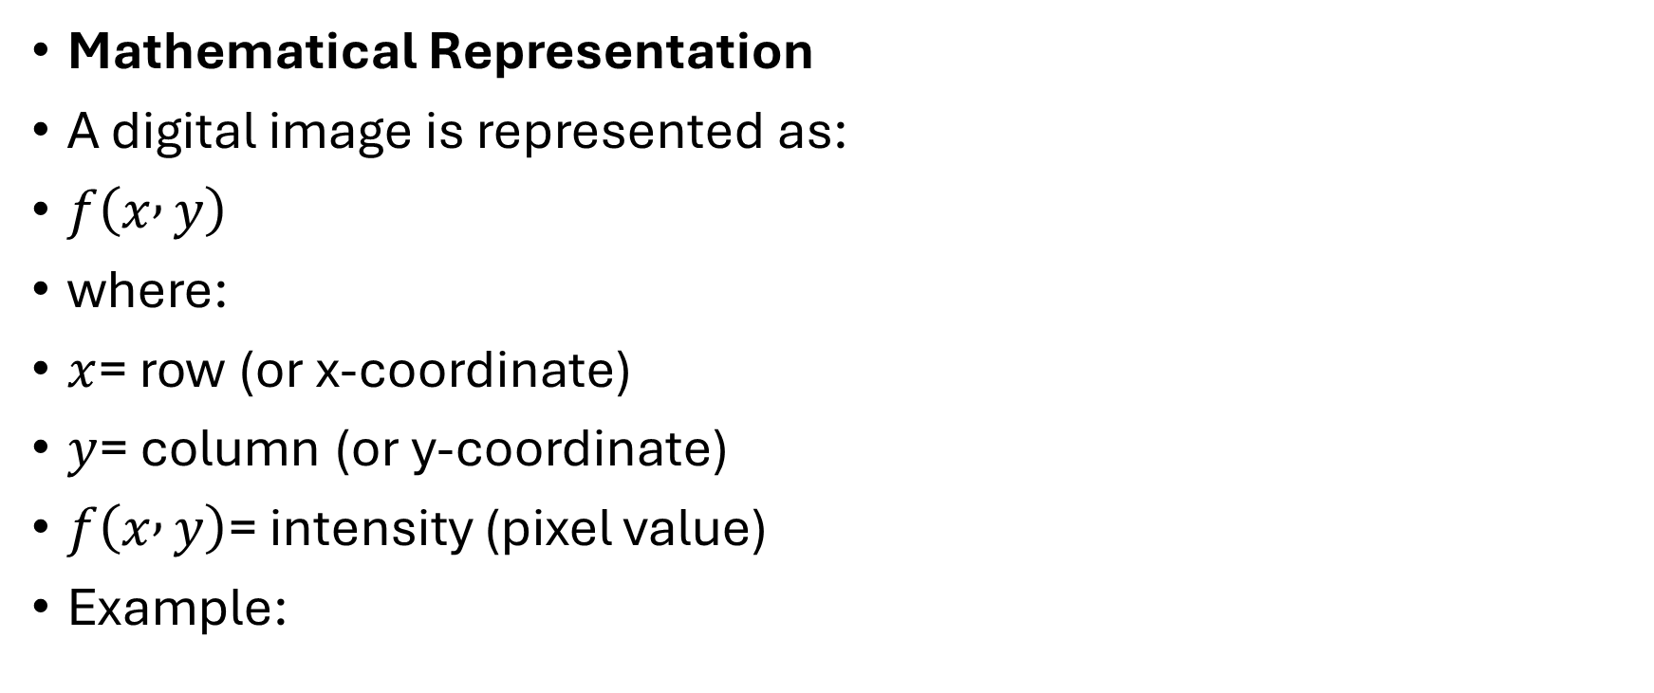
Mathematical Representation
A digital image is represented as:
$f\left(x , y\right)$
where:
$x$= row (or x-coordinate)
$y$= column (or y-coordinate)
$f\left(x , y\right)$= intensity (pixel value)
Example:

Slide 8
f(0,0)=255
f(0,1)=180
f(1,2)=100

Slide 9
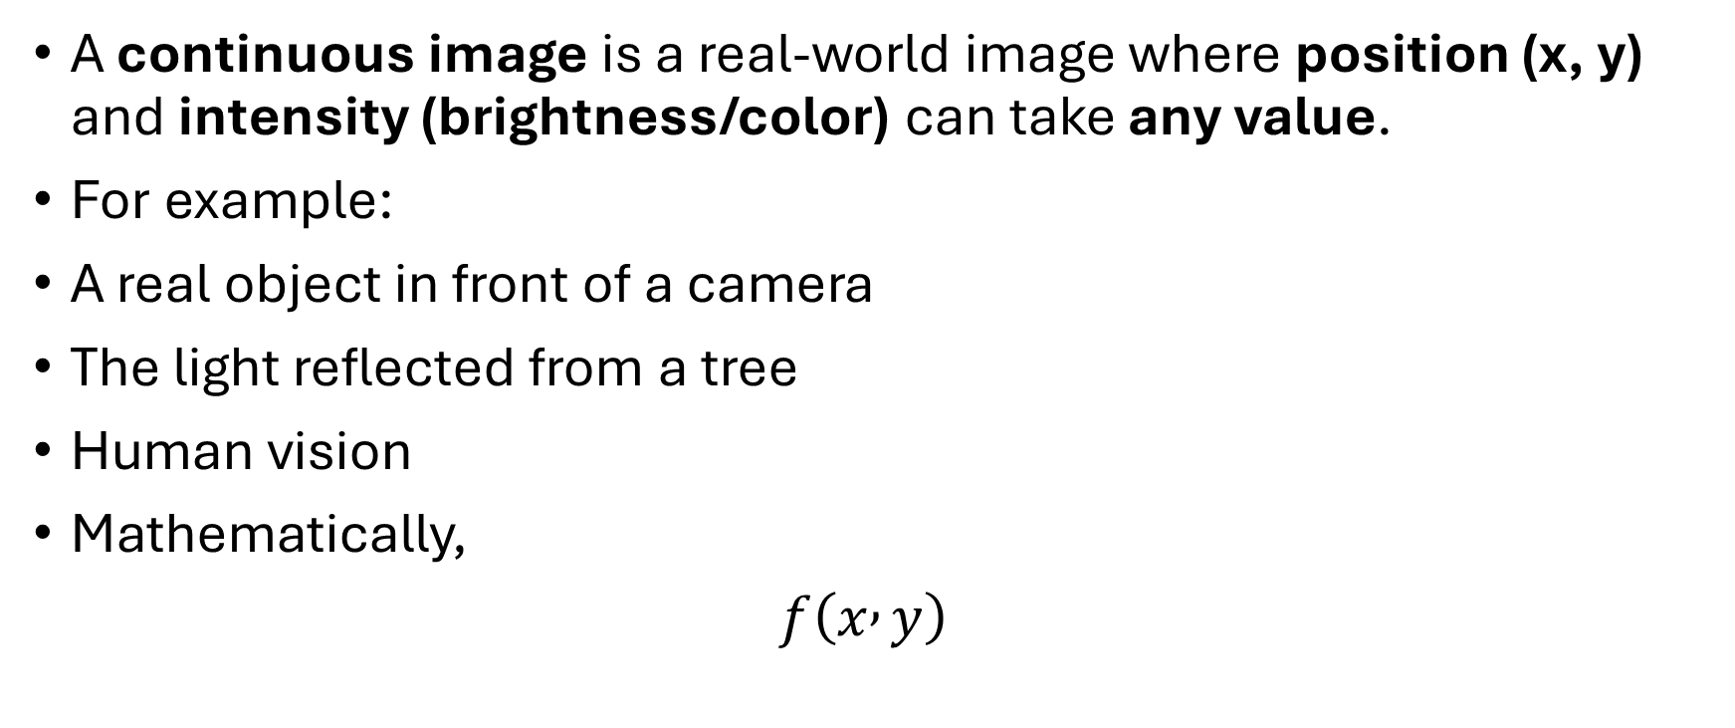
Continuous Image
A continuous image is a real-world image where position (x, y) and intensity (brightness/color) can take any value.
For example:
A real object in front of a camera
The light reflected from a tree
Human vision
Mathematically,
$f\left(x , y\right)$

Slide 10
where:
x = horizontal position (continuous)
y = vertical position (continuous)
f(x,y) = intensity (continuous)

Slide 11
Discrete Image (Digital Image)
A discrete image is obtained by converting the continuous image into pixels.
Instead of infinite points, we store only selected positions.
The image is represented by pixels.
255 240 230 210
200 180 150 120
90 70 60 40

Slide 12
Finite number of pixels
Finite intensity values
Stored in a computer
Can be processed using OpenCV

Slide 13
Sampling
Sampling is the process of converting a continuous image into a grid of pixels.
It decides how many pixels the image will have.
Example
More squares (high sampling):
Imagine drawing a smiley face using squares.
Looks clear.

Slide 14
Looks clear.
Fewer squares (low sampling):
Looks blurry or blocky.
Real Example
1920 × 1080 → More pixels → Better quality
320 × 240 → Fewer pixels → Lower quality
Sampling changes the number of pixels (resolution).

Slide 15
Quantization
Quantization is the process of deciding how many brightness (intensity) levels each pixel can have.
It changes the quality of brightness, not the number of pixels.
Suppose a grayscale image has these intensity values:
25 80 150 240
After quantization to fewer levels:
0 64 128 192

Slide 16
Now the image has fewer shades of gray.
Real Example
8-bit image → 256 gray levels (0–255)
4-bit image → 16 gray levels
2-bit image → 4 gray levels
Quantization changes the number of intensity levels.

Slide 17
Bits | Number of Gray Levels
1-bit | 2 (0, 1)
2-bit | 4 (0, 85, 170, 255)
4-bit | 16
8-bit | 256 (0–255)

Slide 18
GAUSSIAN BLUR
Imagine this image
Each number is the brightness of one pixel.
10 20 30
40 50 60
80 90
The center pixel is 50.

Slide 19
Without blur
The center pixel stays: 50
With a normal average blur
OpenCV averages all 9 pixels.
10+20+30+40+50+60+70+80+90 = 450 450/9 = 50
So the center pixel becomes 50.
Every neighboring pixel is treated equally.

Slide 20
With Gaussian Blur
Gaussian blur says:
Pixels close to the center are more important than pixels far away.
Imagine these weights:
1 2 1
2 4 2
1 2 1

Slide 21
Notice the center (4) has the highest importance.
Now multiply each pixel by its weight.
10×1 = 10
20×2 = 40
30×1 = 30
40×2 = 80
50×4 = 200
60×2 = 120

Slide 22
70×1 = 70
80×2 = 160
90×1 = 90
Add them: 10+40+30+80+200+120+70+160+90 = 800
Add all weights: 1+2+1+2+4+2+1+2+1 = 16
New pixel:800/16 =50
So the center pixel becomes 50.

Slide 23
Another example
Suppose one noisy pixel exists.
Average Blur
Average:
10+20+30+40+255+60+70+80+90 = 655
655/9 = 72
New center: 255 → 72

Slide 24
Gaussian Blur
Since the center has the highest weight, the result is different.
It might become around:255– 110
It still smooths the image but keeps nearby pixels more influential than distant ones.

Slide 25
Why use Gaussian Blur?
Suppose your image has tiny unwanted dots (noise).
After Gaussian Blur: The tiny white dot gets smoothed out.
Real-life analogy
Imagine you're looking through:
A clean window → Image is sharp.
A slightly foggy window → Everything looks softer.
Gaussian Blur creates that soft, smooth effect.

Slide 26
blur = cv2.GaussianBlur(img, (5,5), 0)
Look at a 5×5 square around each pixel.
Give more importance to the center pixels.
Replace the center pixel with the weighted average.
Repeat this for every pixel in the image.

Slide 27
Average Blur: Every neighboring pixel has equal importance. Gaussian Blur: Closer neighbors matter more, farther neighbors matter less, producing a smoother and more natural blur.

Slide 28
What is Bilateral Filter?
Imagine you have a green car on a white background.
Gaussian Blur
Gaussian blur mixes neighboring pixels.
So the edge becomes blurry.
Notice the green and white colors mix into yellowish pixels.
Edges become blurry.

Slide 29
Median Filter
Median Blur is an image enhancement/restoration technique used to remove noise (especially salt-and-pepper noise) while preserving edges.
Unlike average blur, it does not average the pixels. Instead, it chooses the middle (median) value of the neighboring pixels.
cv2.medianBlur(src, ksize)

Slide 30
HOW IT WORKS
Suppose the neighboring pixel values are:
10 20 30
15 255 25
20 30 35
The center pixel is 255, which is noise.

Slide 31
Step 1: Arrange all values
10
15
20
20
25
30
30
35
255

Slide 32
Step 2: Find the middle value
The median value is 25
So 255 is replaced by 25.
The noisy pixel disappears.

Slide 33
Why use Median Blur?
It is mainly used to remove:
Salt noise (white dots)
Pepper noise (black dots)
Salt-and-pepper noise
while keeping edges sharp.

Slide 34
3 → Slight smoothing
5 → Moderate smoothing
7 → Strong smoothing
Larger kernels remove more noise but may also remove some fine details.
Average Blur | Median Blur
Takes the average of neighboring pixels | Takes the median (middle) value
Can blur edges | Preserves edges better
Good for general smoothing | Best for salt-and-pepper noise

Slide 35
Situation | Best Filter
General smoothing | Average Filter
Random (Gaussian) noise | Gaussian Filter
Black & white dot (salt-and-pepper) noise | Median Filter
Want to preserve edges while removing salt-and-pepper noise | Median Filter

Slide 36
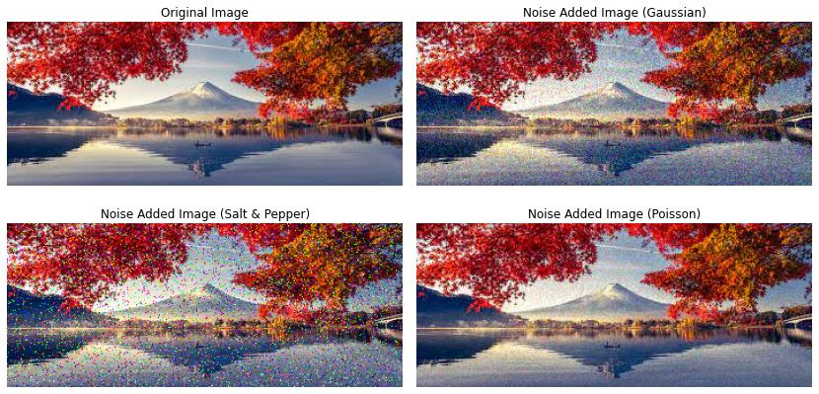

Slide 37
Bilateral Filter
Bilateral filter smooths only similar colors.
It says:
"If two neighboring pixels have very different colors, don't mix them."
Noise inside the green region is removed, but the edge remains sharp.
Gaussian Blur Ignores the different Value but Bilateral Filter don’t.

Slide 38
Parameters
1. Diameter of the neighborhood.
It means OpenCV looks at a 9×9 area around each pixel.
Larger value → stronger smoothing.
2. 75
This is sigmaColor.
First 75 → "Are you my color?"

Slide 39
Suppose the center pixel is green.
Nearby pixels: g,g,g,r,b
The center asks:
"Who has a color similar to mine?"
If a pixel is also green:
It says:"Come, let's mix.“
If a pixel is red:
It says:
"No! You're too different."
This first 75 decides how similar the colors must be.
First 75 = Color friendship.

Slide 40
Second 75 → "Are you close to me?“
Imagine: The center pixel asks:
"Are you sitting close to me?"
Nearby pixels: can help
Very far pixels: cannot help much.
The second 75 decides how far away a pixel can be and still influence the center.
Second 75 = Distance friendship.

Slide 41
Imagine you're in a classroom.
You want help with homework.
You will ask classmates who are:
Sitting near you (distance)
AND
Speaking the same language (similar color)

Slide 42
You won't ask:
Someone sitting across the room
Someone speaking a completely different language
That's exactly what the bilateral filter does.

Slide 43
9 → How many neighbors should I check?
75 → Are their colors similar to mine?
75 → Are they close enough to me?

Slide 44
Image Sharpening
Imagine a blurry image.
After sharpening: Edges become clearer and more defined.
Suppose the image is:
100 100 100
100 120 100
100 100 100
The center pixel is 120.
The new value is calculated as:

Slide 45
(0×100)
+(-1×100)
+(0×100)
+(-1×100)
+(5×120)
+(-1×100)
+(0×100)
+(-1×100)
+(0×100)

Slide 46
Simplify:
= -100 -100 +600 -100 -100= 200
So:
120 → 200
The center becomes brighter than its surroundings, making the edge stand out.

Slide 47
HISTOGRAM
A histogram is a graph that shows how many times each pixel intensity appears in an image.
A histogram tells you how the brightness values are distributed in an image.
20 20 50
50 100 100
150 150 255

Slide 48
The histogram would count how many times each intensity occurs:
Pixel Intensity | Number of Pixels
20 | 2
50 | 2
100 | 2
150 | 2
255 | 1

Slide 49
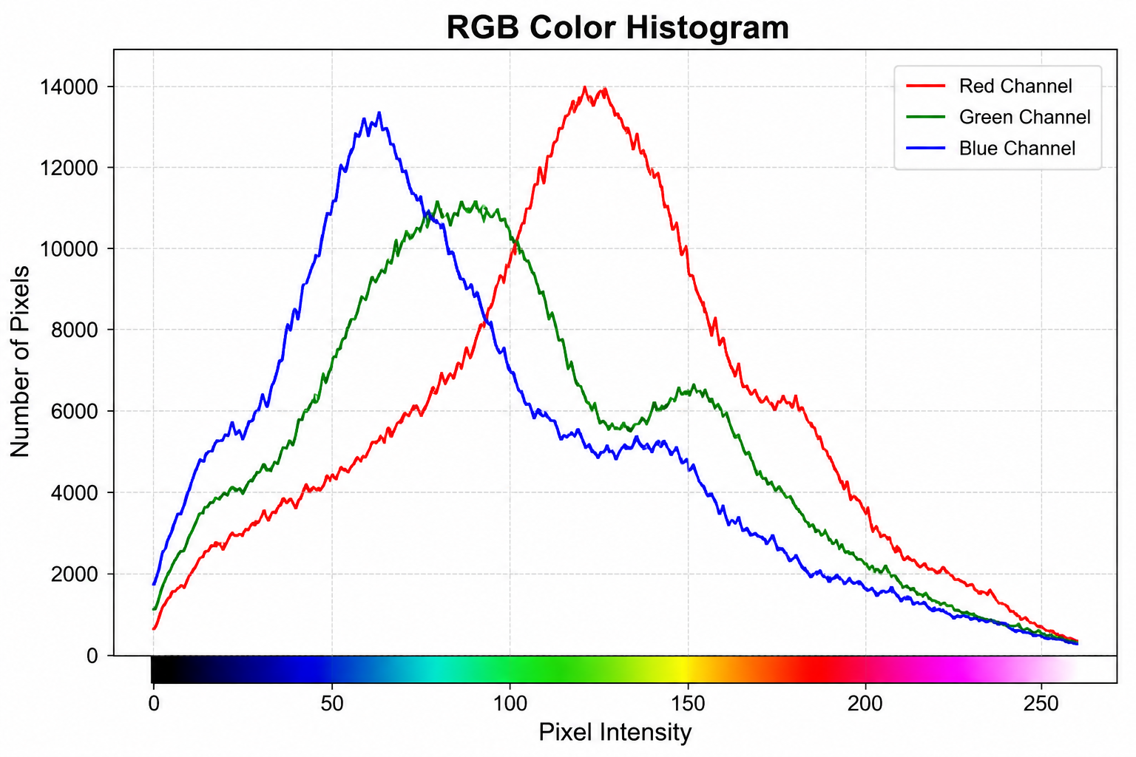

Slide 50
In Images
A grayscale image has pixel values from:
0 → Black
255 → White
The histogram counts how many pixels have each value between 0 and 255.

Slide 51
For example:
Pixel Value : Count
0 → 500 pixels
1 → 450 pixels
2 → 430 pixels
...
255 → 120 pixels

Slide 52
Why is it useful?
A histogram helps you understand an image's brightness.
1. Dark Image
Most pixels are close to 0.
The image appears mostly black or dark.
2. Bright Image
Most pixels are close to 255.
The image appears mostly white or bright.

Slide 53
3. High Contrast Image
Pixels are spread across the full range.
The image has good contrast with dark, gray, and bright regions.
4. Low Contrast Image
Most pixels are concentrated in the middle.
The image looks dull because it uses only a small range of brightness values.

Slide 54
How OpenCV calculates it
hist = cv2.calcHist([gray], [0], None, [256], [0, 256])
This counts the number of pixels for every grayscale value from 0 to 255.
First Arg= Image
Second Arg= Color channel
Third argument= None means Use the entire image.
If you wanted only part of the image, you could provide a mask.

Slide 55
Fourth argument= [256]
Number of histogram bins.
Since grayscale has intensity value
0–255 so there are 256 bins
One bin for each intensity value.
Fifth argument= [0,256]
(OpenCV uses the upper bound as exclusive, so [0,256] covers all values 0–255.)

Slide 56
A histogram bin is a container (or bucket) that counts how many values fall within a certain range.
For an 8-bit grayscale image, pixel values range from:
0 -------------------------> 255
Black White
there are 256 bins.

Slide 57
Bin Number | Pixel Intensity | Count
Bin 0 | 0 | Number of black pixels
Bin 1 | 1 | Number of pixels with intensity 1
Bin 2 | 2 | Number of pixels with intensity 2
... | ... | ...
Bin 255 | 255 | Number of white pixels

Slide 58
What is Histogram Equalization?
Suppose your photo is too dark.
Everything looks dark.
Histogram Equalization spreads the brightness values so the image becomes clearer.
The image now has better contrast.
cv2.equalizeHist(gray) automatically improves the contrast of a grayscale image by redistributing its pixel intensity values across the full range (0–255), making details easier to see.

Slide 59
imagine 10 students standing in one corner of a room.
Before:
Everything is crowded.
Now ask them to spread across the whole room.
After:
Now everyone is easier to see.

Slide 60
Histogram equalization does the same thing with pixel brightness values.
Before: brightness values are crowded together.
After: brightness values are spread out.

Slide 61
CLAHE (Contrast Limited Adaptive Histogram Equalization)
Histogram Equalization: The teacher gives the same instruction to the whole class.
CLAHE: The teacher divides the class into 8 small groups and helps each group individually.
It is a technique used to improve the contrast of an image.

Slide 62
Problem with Histogram Equalization
Suppose the image is
Left side is dark.
Right side is already bright.
Histogram Equalization improves the entire image together.
Sometimes the bright part becomes too bright.
Sometimes the dark part still doesn't look good.

Slide 63
CLAHE solves this problem
Instead of improving the whole image together,
CLAHE divides the image into small pieces.
clahe = cv2.createCLAHE(clipLimit=2.0)
1. cliplimit
This controls how much contrast is increased.
Small value
clipLimit=1
Little improvement.

Slide 64
Medium
clipLimit=2
Balanced improvement.
Large
clipLimit=10
Very strong contrast.
Sometimes too much.
Think of it like adjusting a TV's contrast:

Slide 65
Low = soft image
Medium = natural image
High = very sharp, but may also highlight noise
2. tileGridSize
tileGridSize=(8,8)
This divides the image into
8 × 8 = 64 tiles

Slide 66
Smaller tiles= larger blocks and vice versa
CLAHE improves image contrast by dividing the image into small tiles, enhancing each tile separately, and limiting excessive contrast so that details become clearer without making the image look unnatural or amplifying too much noise.

Slide 67
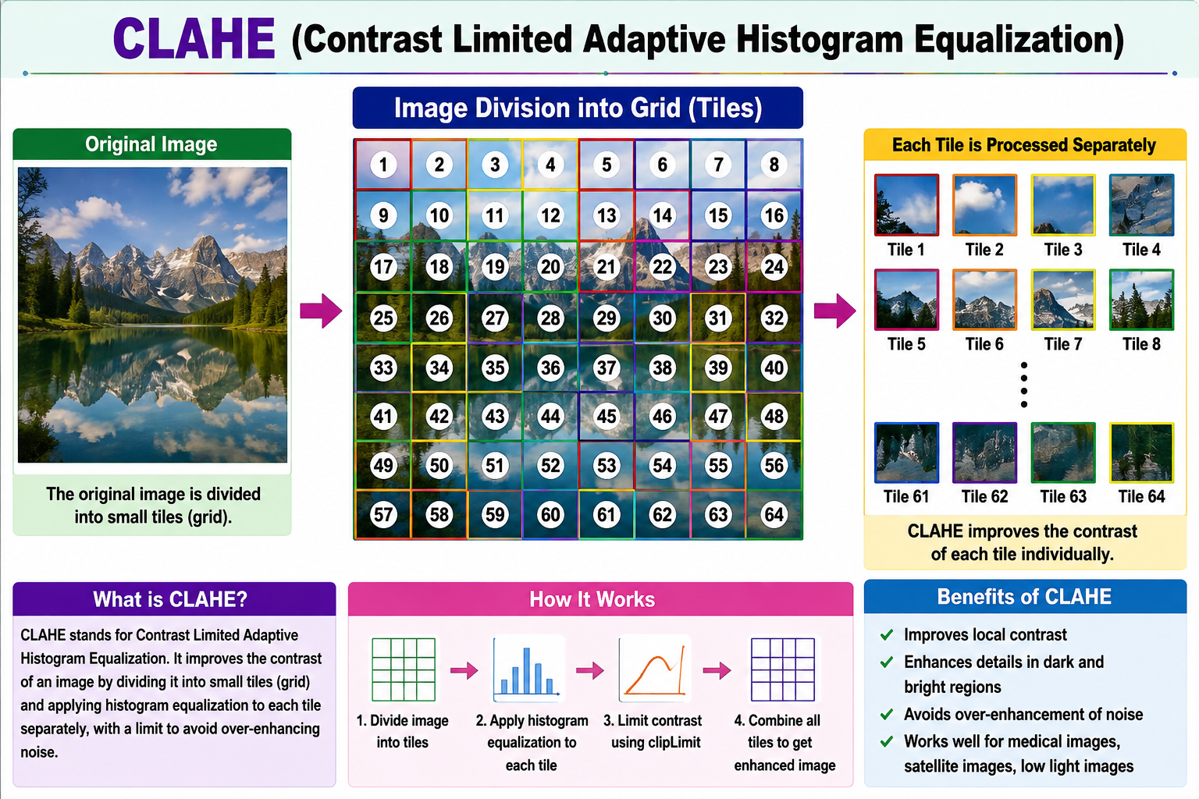

Slide 68
What is a Contour?
A contour is simply the boundary (outline) of an object.
Why threshold?
Because OpenCV detects contours only on binary images.
contours, hierarchy = cv2.findContours( th, cv2.RETR_TREE, cv2.CHAIN_APPROX_SIMPLE )

Slide 69
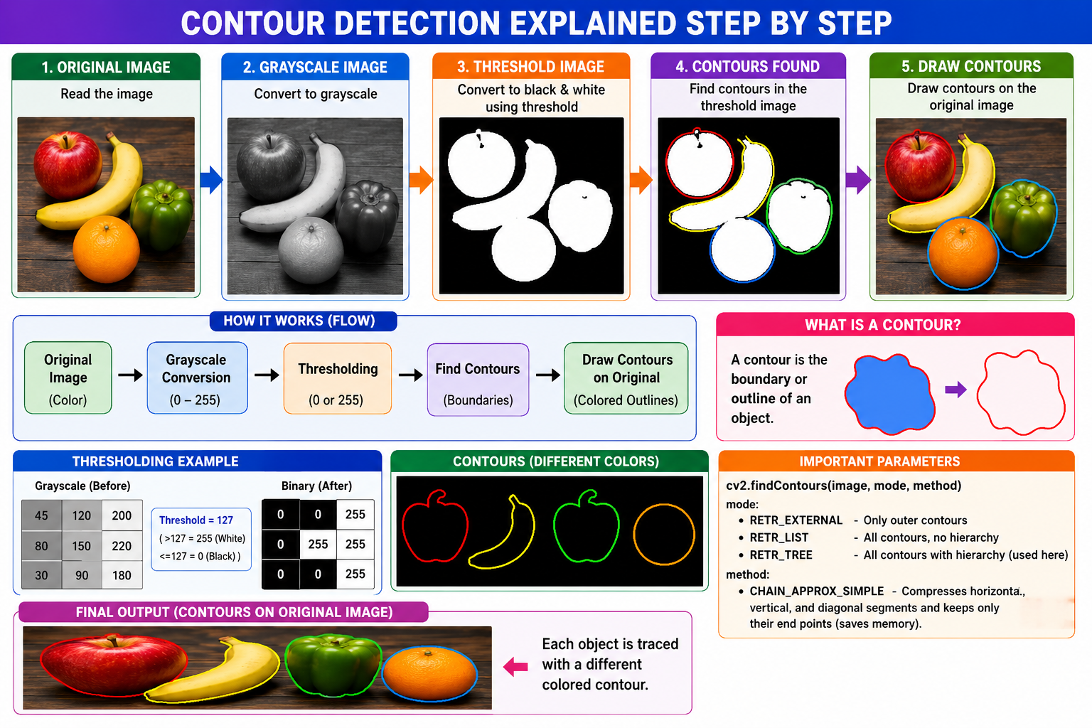

Slide 70
Histogram Matching
Imagine you have two drawings.
Source Image
This is the picture you want to change.(dark cat)
Target Image
This is the picture whose colors and brightness you like. (bright cat)

Slide 71
Histogram Matching
The computer says:
"Make the source image look like the target image."
It changes:
Brightness
Darkness
Color distribution

Slide 72
The computer wants to know:
Where is the circle?
Where is the square?
Where is the triangle?
First, OpenCV finds the boundary (outline) of each shape.
This boundary is called a contour.

Slide 73
Look at each shape one by one.
Suppose there are 3 shapes.
Contour 1 = Circle
Contour 2 = Square
Contour 3 = Triangle

Slide 74
Calculate how much space is inside this shape.
Convex Hull:
Imagine you have a rubber band.
Suppose your object looks like this:
It has dents.
Now stretch a rubber band around it.
The rubber band cannot go inside the dents.

Slide 75
cv2.convexHull() is useful whenever you want the outer shape of an object instead of every tiny detail in its boundary.
Here are the most common uses.
1. Object Detection
Suppose you detect an apple.
The contour may have many small dents because of noise.
Convex Hull gives a smooth outer boundary.

Slide 76
2. Hand Gesture Recognition
This is one of the most common uses.
Original hand
The spaces between fingers are dents.
Convex Hull wraps around the hand.
Then OpenCV measures the gaps (called convexity defects) to count fingers.

Slide 77
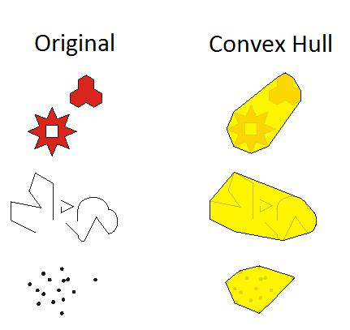

Slide 78
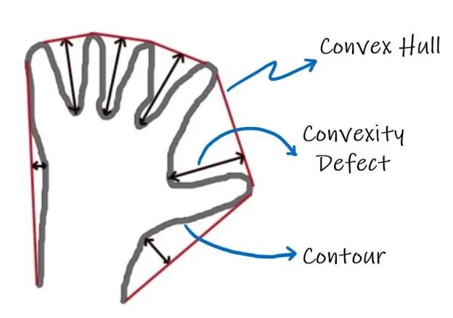

Slide 79
Adaptive threshold
I'll choose a different threshold for different areas of the image.“
This is useful when the image has uneven lighting.
One threshold may not work well for both areas.
Adaptive threshold looks at a small neighborhood around each pixel and calculates a suitable threshold for that area.
Normal threshold:
"Everyone in the whole image uses threshold = 100."
Adaptive threshold:
"You use the threshold suitable for your neighborhood; you use yours; you use yours..."

Slide 80
REGION BASED REPRESENTATION
Imagine your binary image contains separate white objects:
There are 2 separate white objects.
connectedComponents() finds them.
num_labels tells you how many regions/labels were found.
OpenCV also counts the background as a component.

Slide 81
seed = (100, 100)
This is very important.
It means:
Start the flood fill at coordinate (100, 100).
It is an OpenCV function used to fill a connected region with a new color.

Slide 82
Imagine the image is:
⬜⬜⬜
⬜⬜⬜
⬜⬜⬜
Flood fill's mask needs a 1-pixel border around it:
⬛⬛⬛⬛⬛
⬛⬜⬜⬜⬛
⬛⬜⬜⬜⬛
⬛⬜⬜⬜⬛
⬛⬛⬛⬛⬛

Slide 83
There is:
1 extra row at the top
1 extra row at the bottom → +2 height
1 extra column on the left
1 extra column on the right → +2 width

Slide 84
Watershed segmentation
Watershed segmentation is a technique used to separate objects that are touching each other.
Think about mountains and water.
Now imagine rain falling
Water fills the low areas. When water from two different areas is about to meet, we build a boundary between them.
That boundary is the watershed line.

Slide 85
Watershed = separate touching objects by finding boundaries between them.
It's especially useful for counting cells, separating touching coins, separating objects in medical images, etc.

Slide 86
⬛⬛⬛⬛⬛⬛⬛
⬛⬜⬜⬛⬛⬜⬛
⬛⬜⬜⬛⬛⬜⬛
⬛⬛⬛⬛⬛⬛⬛
There are 2 separate white objects.

Slide 87
0 0 0 0 0 0 0
0 1 1 0 0 2 0
0 1 1 0 0 2 0
0 0 0 0 0 0 0
0 → background
1 → object 1
2 → object 2

Slide 88
What is distanceTransform()?
cv2.distanceTransform() calculates the distance of each foreground pixel from the nearest background pixel.
You have a white circle on a black background:
The pixels near the edge are close to the black background.
The pixels in the middle are far from the black background.
So OpenCV calculates:

Slide 89
Edge → small distance
Middle → large distance
So distanceTransform() creates a kind of distance map.
Black = 0
White = 255
Object
↓
000000000
000111000
001111100
001111100
000111000
000000000

Slide 90
Here, the white pixels (1/255) are the foreground, and black pixels (0) are the background.
The distance transform works on this binary image.
cv2.DIST_L2
specifies how distance should be calculated.
L2 means Euclidean distance.

Slide 91
For example, suppose we have two pixels:
A
|
| 3 pixels
|
|
B
The Euclidean distance is: 3

Slide 92
But imagine diagonal movement:
A ●
\
\
● B
Euclidean distance is based on:
d=(x2​−x1​)^2+(y2​−y1​)^2​
For example:
d=underoot(3^2+4^2​) d=5
So DIST_L2 basically means:
Use normal geometric/Euclidean distance.

Slide 93
Whats the need of :
Suppose we have two touching coins:
The two coins are touching.
After thresholding, they may look like one connected object:
We need to tell watershed:
"This area belongs to object 1."
and
"This area belongs to object 2."
The distance transform helps us find the center of each object.

Slide 94
We use distanceTransform() to find the center/core of each object.
Watershed uses these points to separate the touching objects.
Imagine a white object on a black background:
or every white pixel, distanceTransform() asks:
"How far am I from the nearest black pixel (edge)?“
operation is "cv2.distanceTransform" which calculates the distance of each white pixel in the binary image to the closest black pixel.

Slide 95
The center gets the biggest number because it is farthest from the boundary.
Edge → small distance
↓
1 2 3
2 3 4
3 4 5 ← center
2 3 4
1 2 3
↑
Edge → small distance

Slide 96
So OpenCV doesn't literally say "this is the center."
Instead, it calculates the distance for every pixel. Then the pixels with the largest distances are considered the center/core.
_, sure_fg = cv2.threshold(
dist,
0.5 * dist.max(),
255,
0
)

Slide 97
Taking the distance-transform image and keeping only the pixels that are most likely to be the center of the objects.
First, remember dist
1 2 3 2 1
2 3 4 3 2
3 4 5 4 3
2 3 4 3 2
1 2 3 2 1

Slide 98
The large numbers are near the center.
his says:
Keep only pixels whose distance is at least 50% of the maximum distance.
dist.max() = 10
0.5 × 10 = 5
So the threshold is 5.
Anything below 5 is removed.

Slide 99
Before:
1 2 3 2 1
2 3 4 3 2
3 4 10 4 3
2 3 4 3 2
1 2 3 2 1
↓ threshold = 5
After:
0 0 0 0 0
0 0 0 0 0
0 0 255 0 0
0 0 0 0 0
0 0 0 0 0

Slide 100
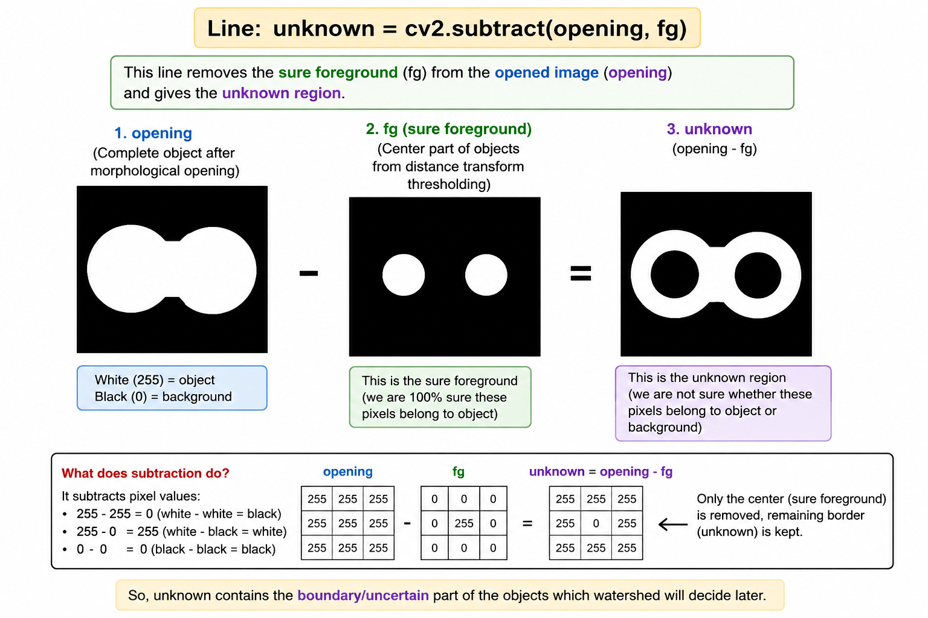
So we keep the central/sure part of the object.

Slide 101
opening = complete object
  It contains the whole white object.
fg = sure foreground
  It contains only the center/core of the object.
  We are very sure these pixels belong to the object.
We subtract fg from opening
  This removes the center.
  What remains is the uncertain/unknown area.
Why find the unknown area?
  Because watershed needs to know which pixels are uncertain.
  Watershed will decide whether those pixels belong to one object or another.
This is especially useful for touching objects.

Slide 102
Watershed can use the known centers as starting points and figure out the boundary.
We do subtraction to remove the part we are already sure about and leave the part that watershed needs to decide.

Slide 103
111111111111
111222221111
1122222222111
111222221111
111111111111

Slide 104
Then the unknown region is changed to 0:
111000000111
112222000311
112222000331
111000000111
111111111111

Slide 105
Now watershed knows
1 → background
2 → object 1
3 → object 2
0 → unknown
Apply Watershed

Slide 106
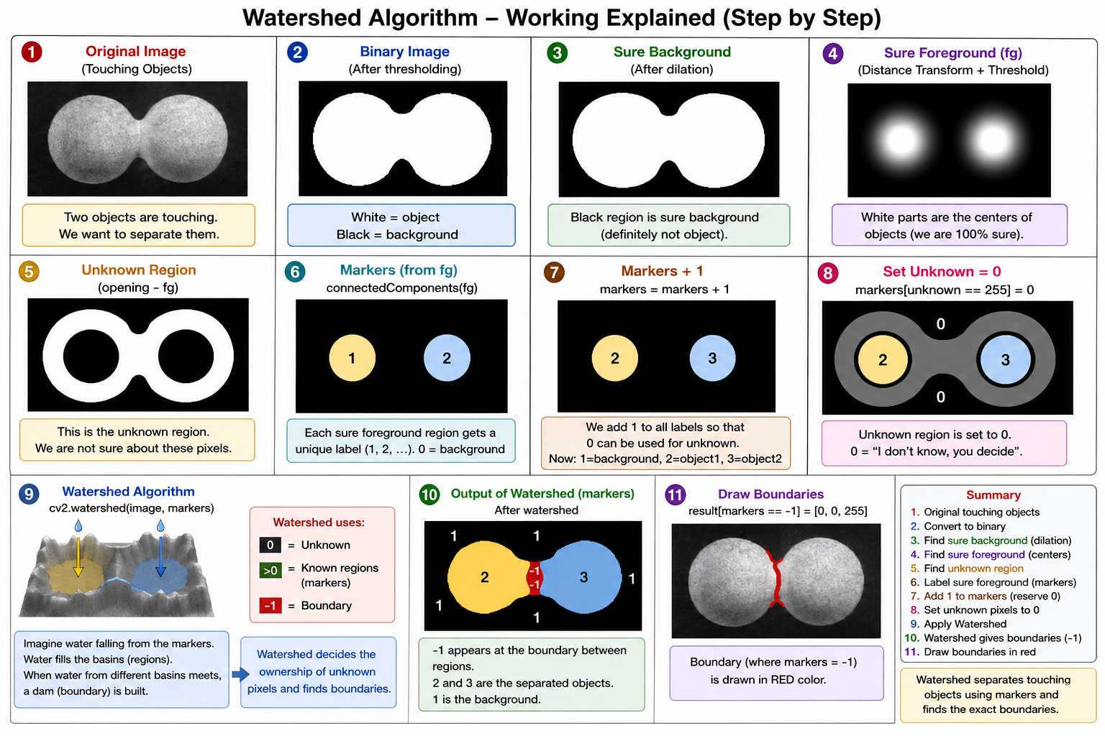

Slide 107
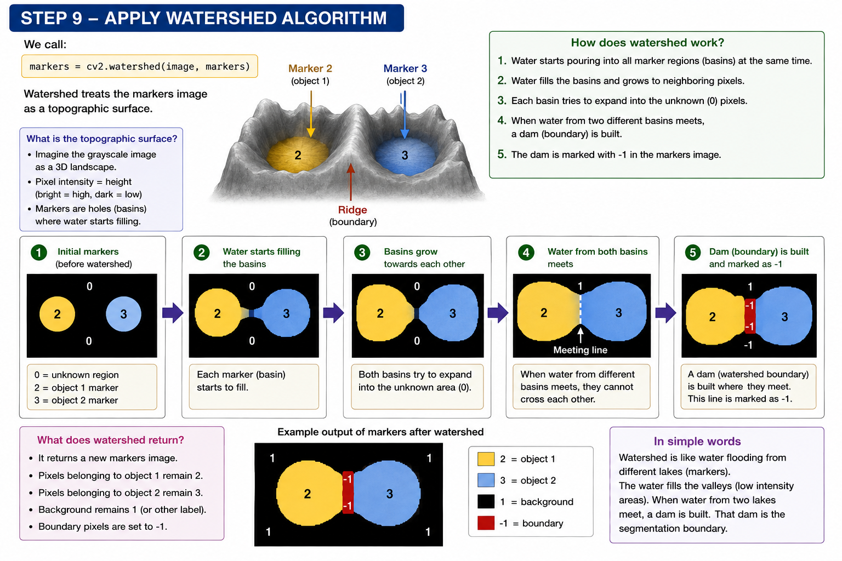

Slide 108
Watershed looks at the pixels around each known object and gradually includes nearby pixels into that object.
Object 1 Unknown Object 2
2 0 3
2 0 3
2 0 3

Slide 109
Watershed does:
2 → 2 3 ← 3
2 → 2 3 ← 3
2 → 2 3 ← 3
When both sides meet:
2 2 | 3 3
2 2 | 3 3
2 2 | 3 3
↑
boundary

Slide 110
so "region grows" simply means: the computer changes unknown pixels into the label of an object (2 or 3) as it determines which object they belong to.
2 grows toward 3, and 3 grows toward 2. When they meet, the meeting line becomes the boundary.

Slide 111
Threshold segmentation means separating an image into different parts using a cutoff value.
Pixel value
0 ---------------- 120 ---------------- 255
| | |
BLACK ↑ WHITE
cutoff

Slide 112
So OpenCV checks every pixel:
If pixel ≤ 120 → 0 → BLACK
If pixel > 120 → 255 → WHITE
Adaptive threshold is like normal thresholding, but instead of using ONE cutoff for the whole image, it chooses a cutoff separately for different areas.

Slide 113
Otsu is a method that automatically chooses the best threshold value for you.
cv2.threshold(gray, 120, 255, cv2.THRESH_BINARY)
With Otsu:
_, otsu = cv2.threshold(
gray,
0,
255,
cv2.THRESH_BINARY + cv2.THRESH_OTSU
)

Slide 114
OpenCV, you choose the best cutoff for me.“
Imagine your image has mostly two groups of pixels:
Dark pixels Bright pixels
20 30 40 50 60 | 180 190 200 210 220
↑
possible cutoff

Slide 115
K-Means Segmentation
An image has thousands or millions of pixels, and every pixel has a color:
Pixel = [Blue, Green, Red]
For example:
[100, 120, 200]
K-Means tries to group pixels with similar colors together.

Slide 116
If:
K = 4
it means:
"Create 4 groups of similar-colored pixels."
Reshape the image:
(height, width, 3) 860 × 1294 × 3
But K-Means wants the data like:
number_of_pixels × 3

Slide 117
So:
Z = img.reshape((-1, 3))
changes:
860 × 1294 × 3
into:
1,112,840 × 3
The -1 says:
"Python, you calculate how many rows are needed."

Slide 118
K-Means works with floating-point numbers.
Define stopping criteria
criteria = ( cv2.TERM_CRITERIA_EPS + cv2.TERM_CRITERIA_MAX_ITER, 10, 1.0 )
This tells K-Means:
"When should you stop calculating?"
EPS means epsilon, which basically means:
Stop when the result is no longer changing much.

Slide 119
criteria = ( type, maximum_iterations, accuracy )
Stop after a maximum number of iterations.
Why use +? Use both stopping conditions.
Maximum 10 iterations.
1 is the epsilon/accuracy condition.
If the K-Means result changes by less than 1, stop

Slide 120
ret, label, center = cv2.kmeans( Z, K, None, criteria, 10, cv2.KMEANS_RANDOM_CENTERS )
Z: This contains all your pixels.
[155,152,154]
[155,152,154]
[166,156,168]
[100,120,200]
...
K-Means looks at these pixels and groups similar ones.

Slide 121
K: So K-Means creates 4 clusters.
None: This is used for labels.
You don't need to provide initial labels because K-Means will create them.
Criteria: This means attempt the K-Means process 10 times with different random starting centers.
Why?
Because K-Means starts with random centers.
Different starting points can produce slightly different results.
Doing it 10 times gives OpenCV a chance to find a better result.

Slide 122
cv2.KMEANS_RANDOM_CENTERS: This means
Start the cluster centers at random positions.
Suppose we have these pixels:
[10,10,10]
[12,11,10]
[15,14,13]
[100,100,100]
[105,102,100]
[200,200,200]
[210,205,200]

Slide 123
And k=3
Cluster 1
↓
[10,10,10]
[12,11,10]
[15,14,13]
Cluster 2
↓
[100,100,100]
[105,102,100]
Cluster 3
↓
[200,200,200]
[210,205,200]

Slide 124
It calculates a representative color for each group.
These representative colors are called centers.
ret, label, center = cv2.kmeans(...): center contains the representative color of each cluster. These are the 4 main colors found by K-Means.
Eg: center[0] → [B,G,R]
center[1] → [B,G,R]
center[2] → [B,G,R]
center[3] → [B,G,R]

Slide 125
Label tells us:
Which cluster does each pixel belong to?

Slide 126
Suppose your image has these pixel colors:
Red-ish pixels:
[250, 20, 20]
[245, 25, 22]
[255, 30, 18]
Blue-ish pixels:
[20, 20, 250]
[25, 25, 245]
[18, 30, 255]

Slide 127
Green-ish pixels:
[20, 250, 20]
[25, 245, 25]
[18, 255, 30]
If k=3
K-Means says:
"I need to make 3 groups."
Step 1 — Pick 3 starting centers
It randomly chooses 3 colors as starting points.
Center 1 = [250, 20, 20]
Center 2 = [20, 20, 250]
Center 3 = [20, 250, 20]

Slide 128
Step 2 — Give every pixel to the closest center
For example:
[250,20,20] → closest to → Cluster 1
[20,20,250] → closest to → Cluster 2
[20,250,20] → closest to → Cluster 3
So each pixel gets a label:
Pixel → Cluster
Pixel 1 → 1
Pixel 2 → 1
Pixel 3 → 2
Pixel 4 → 3
...

Slide 129
Step 3 — Calculate a new center
Now K-Means looks at all pixels in Cluster 1 and calculates their average color.
For example:
[250,20,20]
[245,25,22]
[255,30,18]

Slide 130
Average ≈ [250,25,20]
That becomes the new center.
It does the same for Cluster 2 and Cluster 3.
Step 4 — Repeat
It again asks:
"Is every pixel still closest to its current center?"
If not, pixels move to different clusters.
Then it calculates new centers again.
It keeps doing:

Slide 131
Active Contour (Snake)
Active Contour is a segmentation technique that finds the boundary of an object in an image.
We first put a rough circle/curve around the car:
This is called the initial snake (init).
Then the snake moves and changes its shape to reach the actual boundary:

Slide 132
It is creating the starting circle for your snake
Suppose your image is:
Height = 800
Width = 1000
Then:
min(800, 1000) = 800
800 // 4 = 200
radius = 200

Slide 133
The starting circle will have a radius of 200 pixels.
Why divide by 4?
Because we don't want the starting circle to be too big and go outside the image.
//4 gives us a reasonable starting size.
But it's not compulsory.
//4 is just a practical choice to set the initial snake size. It is not a special rule of Active Contour.

Slide 134
Imagine we have:
center_x = 500
center_y = 400
radius = 200
theta contains 200 different angles around the circle.
For each angle, we calculate a point
So, use those angles to find where each of the 200 points should be placed on the circle.

Slide 135
theta = "Give me 200 positions around the circle.“
np.sin(theta) helps find the position (up/down) for each angle.
sin(theta) tells you how far UP or DOWN the point should be from the center.
cos(theta) tells you how far LEFT or RIGHT the point should be.

Slide 136
morphological_chan_vese: Morphological Chan-Vese is a method for segmenting an image — basically, it tries to separate an object from its background.
You have an image:
⬛⬛⬛⬛⬛⬛⬛
⬛⬛🟡🟡⬛⬛⬛
⬛🟡🟡🟡🟡⬛⬛
⬛⬛🟡🟡⬛⬛⬛
⬛⬛⬛⬛⬛⬛⬛

Slide 137
You want to separate the yellow object from the black background.
Step 1 — Make a starting boundary
It doesn't need to be exactly around the object.
Step 2 — Look inside and outside
It asks:
"What is the image like inside my boundary?
and:
"What is the image like outside my boundary?"

Slide 138
If the inside looks different from the outside, the boundary should move.
Step 3 — Move the boundary: The boundary starts changing:
Then: It keeps moving toward the object boundary.
Step 4 — Repeat
It does this many times:

Slide 139
Start boundary
↓
Check inside/outside
↓
Move boundary
↓
Check again
↓
Move again
↓
...
↓
Final segmentation

Slide 140
Step 5 — Give the result
Finally, it creates a mask:
0 = background
1 = object

Slide 141
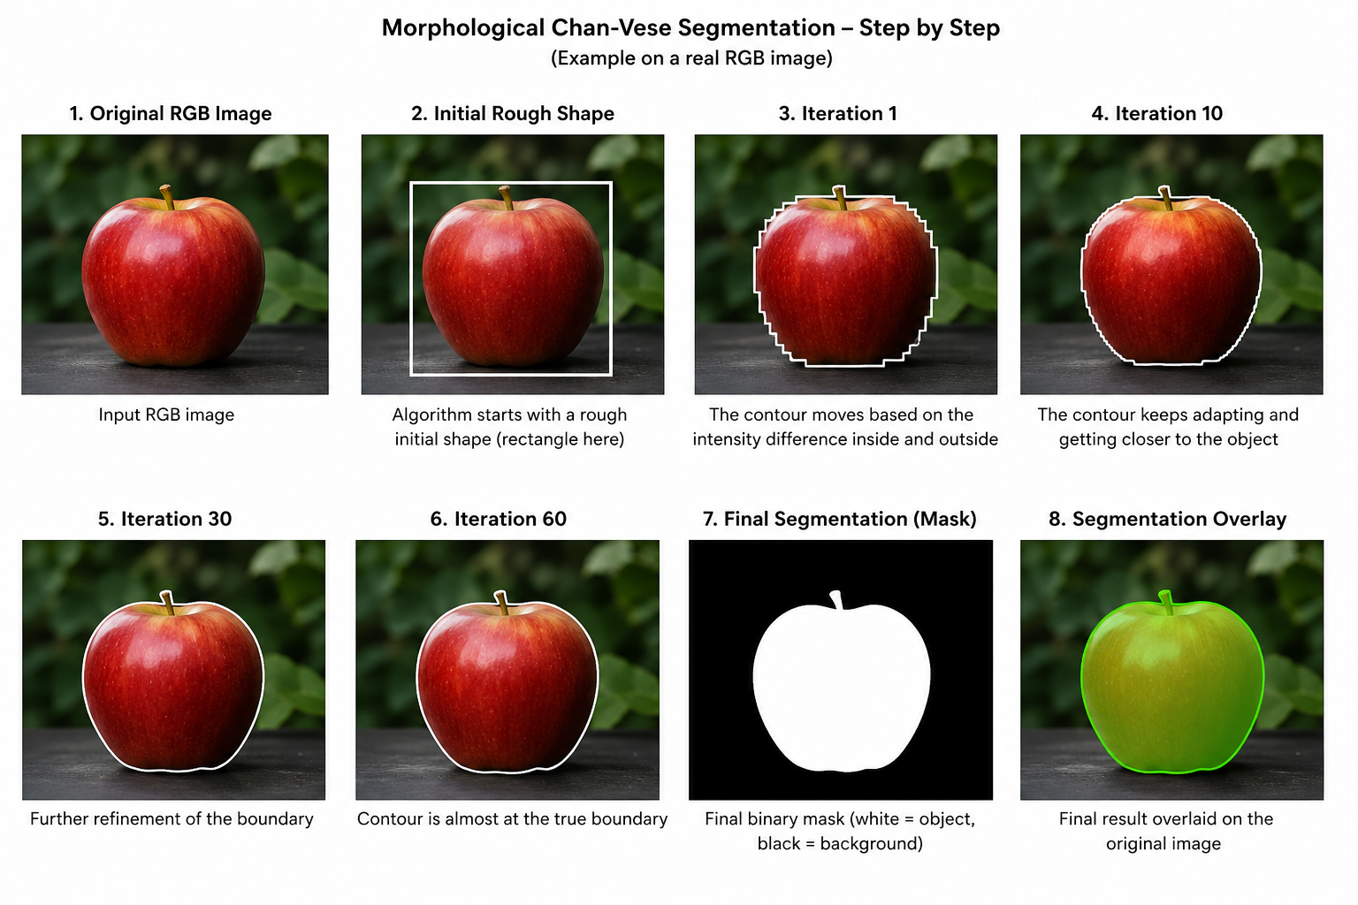

Slide 142
Fourier Descriptor
A Fourier Descriptor is a set of numbers used to describe the shape of an object.
numerical representation of an object's boundary/shape.
Convert BGR → HSV
HSV means:
H = Hue
S = Saturation
V = Value

Slide 143
Why HSV?
Because we want to distinguish the colored apple from the white background.
White has very little color/saturation.
The red apple has much more saturation.
So HSV makes it easier to say:
"Keep the colored pixels and remove the white background."

Slide 144
Define the lower and upper limits
lower = np.array([0, 40, 20])
upper = np.array([179, 255, 255])
These are the limits for the pixels we want to keep.
Keep?
Pixel ────────────────┐
↓ keep
Is it inside
our HSV range?
/ \
YES NO
↓ ↓
WHITE BLACK

Slide 145
lower = "not below this"
upper = "not above this“
H ≥ 0 S ≥ 40 V ≥ 20
Upper
H ≤ 179 S ≤ 255 V ≤ 255
White background:
S ≈ 0
Apple:
S > 40
Therefore, much of the white background gets rejected.

Slide 146
Sobel is an edge detection method.
It looks at neighboring pixels and asks:
"Is the brightness changing a lot here?"
If the brightness changes a lot → there is probably an edge.
Imagine pixels like this:
10 10 10
10 10 10
200 200 200

Slide 147
There is a big brightness change:
10 10 ↓ 200
So Sobel detects an edge there.
sobelx = cv2.Sobel(gray, cv2.CV_64F, 1, 0)
1 → X direction
0 → Y direction
it means use 64-bit floating-point numbers for the Sobel calculation.
CV_64F = "Give Sobel a type that can handle negative and decimal results."

Slide 148
Take a small 3×3 area
Sobel looks at 3×3 pixels at a time:
52 55 61
49 50 56
45 48 51

Slide 149
Use the Sobel X kernel
-1 0 1
-2 0 2
-1 0 1
It looks for changes from left to right
The left side gets negative values and the right side gets positive values.

Slide 150
Multiply corresponding values
52×-1 55×0 61×1 49×-2 50×0 56×2 45×-1 48×0 51×1
Add everything
Gx = 29
This tells us there is a horizontal intensity change in that area.
Do the same with the Sobel Y kernel

Slide 151
1 -2 -1
0 0 0
1 2 1
This detects changes from top → bottom.
We get Gy
Combine Gx and Gy
G = √(Gx² + Gy²)

Slide 152
If g is large string edge
If g is small little/ no edge

Slide 153
Prewitt is an edge detection method.
It looks at a small 3×3 group of pixels and checks whether brightness changes strongly.
Dark area
10 10 10
10 10 10
Bright area
200 200 200
200 200 200

Slide 154
There is a big brightness change → edge.
Kernel It compares the top pixels with the bottom pixels.
If the top is dark: 10 10 10
and bottom is bright: 200 200 200
The calculation is roughly:
(10 + 10 + 10)
-
(200 + 200 + 200)
= -570

Slide 155
A large value means there is a strong change → edge.
filter2D : It takes the kernel and moves it across the entire image.
-1 means: Keep the same data type as the input image.
Prewitt is basically a small 3×3 edge detector that slides across the image and finds places where brightness changes sharply.

Slide 156
Erosion makes the white parts of a binary image smaller.
It basically eats away the edges of white objects.
Erosion = white objects shrink.
Dilation makes the white parts of a binary image bigger.
Dilation = white objects grow/expand.

Slide 157
Erosion vs Dilation
Operation | What happens to white object?
Erosion | Gets smaller
Dilation | Gets bigger
Dilation is also useful for filling small gaps and connecting nearby white regions.

Slide 158
Opening = Erosion + Dilation
It happens in this order:
Binary image
↓
Erosion
↓
Dilation
↓
Opening

Slide 159
Opening is mainly used to remove small white noise from a binary image.
Closing = Dilation + Erosion
The order is important:
Binary image
↓
Dilation
↓
Erosion
↓
Closing

Slide 160
Closing is mainly used to fill small black holes and gaps inside white objects.
Opening = Erosion → Dilation
↓
removes small white noise
Closing = Dilation → Erosion
↓
fills small black gaps

Slide 161
Opening removes small white objects.
Closing fills small black holes/gaps.
What is Morphological Gradient?
It is basically:
Dilation − Erosion
Dilation
↓
BIG object
-
SMALL object
↓
EDGE/OUTLINE
So it is used to find the outline/

Slide 162
means:
binary → input binary image
cv2.MORPH_GRADIENT → calculate the morphological gradient
kernel → the neighborhood used to detect the boundary
Morphological Gradient = find the edges/outline of white objects.

Slide 163
Suppose the white object is:
0 0 0 0 0
0 255 255 0 0
0 255 255 0 0
0 0 0 0 0

Slide 164
After dilation, the white object becomes bigger:
0 255 255 255 0
0 255 255 255 0
0 255 255 255 0
0 255 255 255 0
After erosion, the white object becomes smaller:

Slide 165
0 0 0 0 0
0 0 0 0 0
0 0 0 0 0
0 0 0 0 0
Now:
Gradient = Dilation – Erosion
255 - 0 = 255
around the boundary.
The result highlights the outline:

Slide 166
0 255 255 255 0
0 255 0 255 0
0 255 0 255 0
0 255 255 255 0

Slide 167
hsv = cv2.cvtColor(img, cv2.COLOR_BGR2HSV)
We change the image to HSV because it makes it easier to identify the colored apple.
"Find the colored part and ignore the white background.
HSV is just another way of describing the color of a pixel.
HSV stands for:
H = Hue → What color is it?
S = Saturation → How strong/pure is the color?
V = Value → How bright or dark is it?

Slide 168
Imagine a red apple:
H (Hue):
"Is this pixel red, green, blue, etc.?"
S (Saturation):
"How strongly red is it?"
Very red → high saturation
Pale/light red → low saturation
V (Value):
"How bright is it?"
Bright red → high value
Dark red → low value

Slide 169
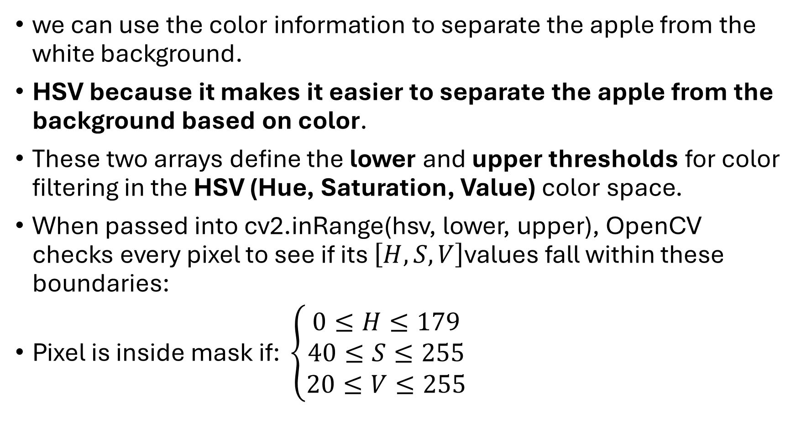
we can use the color information to separate the apple from the white background.
HSV because it makes it easier to separate the apple from the background based on color.
These two arrays define the lower and upper thresholds for color filtering in the HSV (Hue, Saturation, Value) color space.
When passed into cv2.inRange(hsv, lower, upper), OpenCV checks every pixel to see if its $\left[H,S,V\right]$values fall within these boundaries:
$\text{Pixel is inside mask if: }\left\{\begin{matrix}0≤H≤179 \\ 40≤S≤255 \\ 20≤V≤255\end{matrix}\right.$

Slide 170
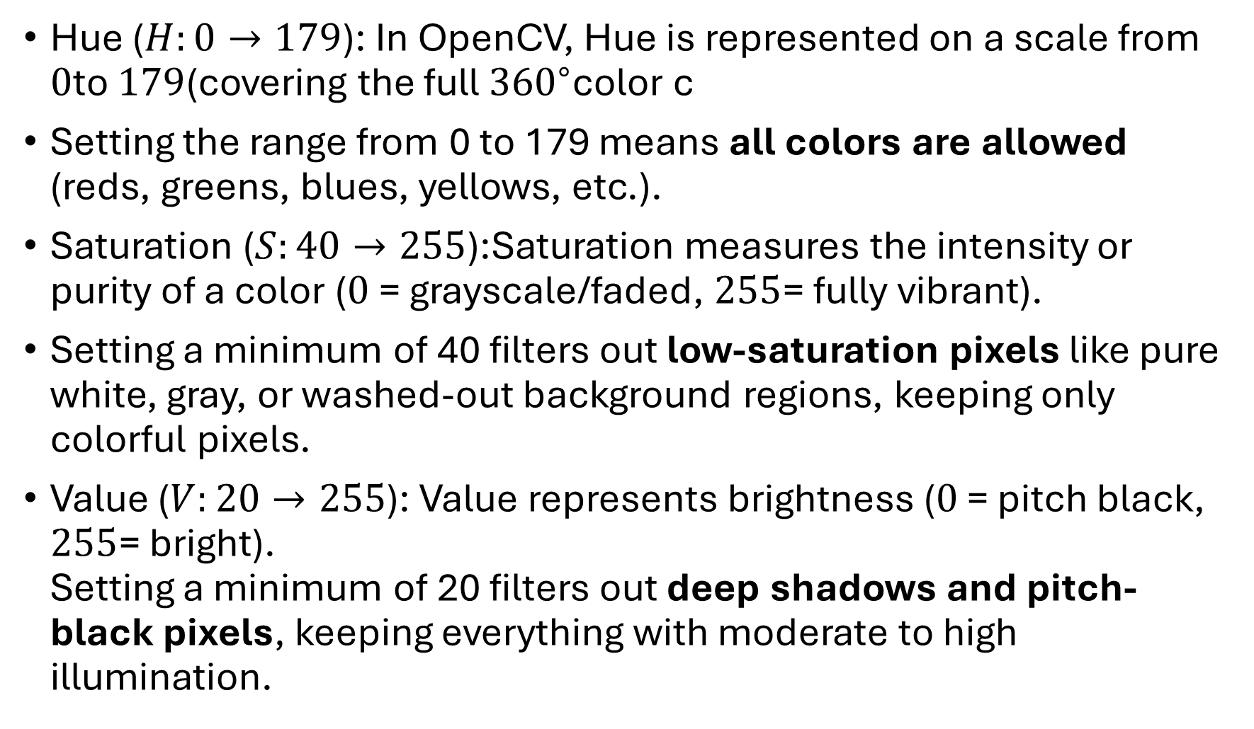
Hue ($H:0→179$): In OpenCV, Hue is represented on a scale from $0$to $179$(covering the full ${360}^{∘}$color c
Setting the range from 0 to 179 means all colors are allowed (reds, greens, blues, yellows, etc.).
Saturation ($S:40→255$):Saturation measures the intensity or purity of a color ($0$ = grayscale/faded, $255$= fully vibrant).
Setting a minimum of 40 filters out low-saturation pixels like pure white, gray, or washed-out background regions, keeping only colorful pixels.
Value ($V:20→255$): Value represents brightness ($0$ = pitch black, $255$= bright).
Setting a minimum of 20 filters out deep shadows and pitch-black pixels, keeping everything with moderate to high illumination.

Slide 171
If a spot is too dark to clearly see what color it is (under 20), ignore it. If there is enough light to see it (20 or above), keep it.
upper = np.array([179, 255, 255]) sets the highest possible limit for the color filter in OpenCV's HSV system.
It tells the computer: Don't cut off anything at the top—allow the maximum possible of everything.
The Three Numbers Explained
179 (Hue / Color Type):
In OpenCV, all colors on the color wheel fit between 0 and 179.
Setting this to 179 means: "Allow every color up to the very end of the color wheel."

Slide 172
255 (Saturation / Color Richness):
Saturation goes from 0 (faded/gray) to 255 (super rich and vibrant).
Setting this to 255 means: "Allow the most vibrant, intense colors possible.“
255 (Value / Brightness):
Brightness goes from 0 (pitch black) to 255 (maximum light).
Setting this to 255 means: "Allow the brightest, most lit-up pixels possible."

Slide 173
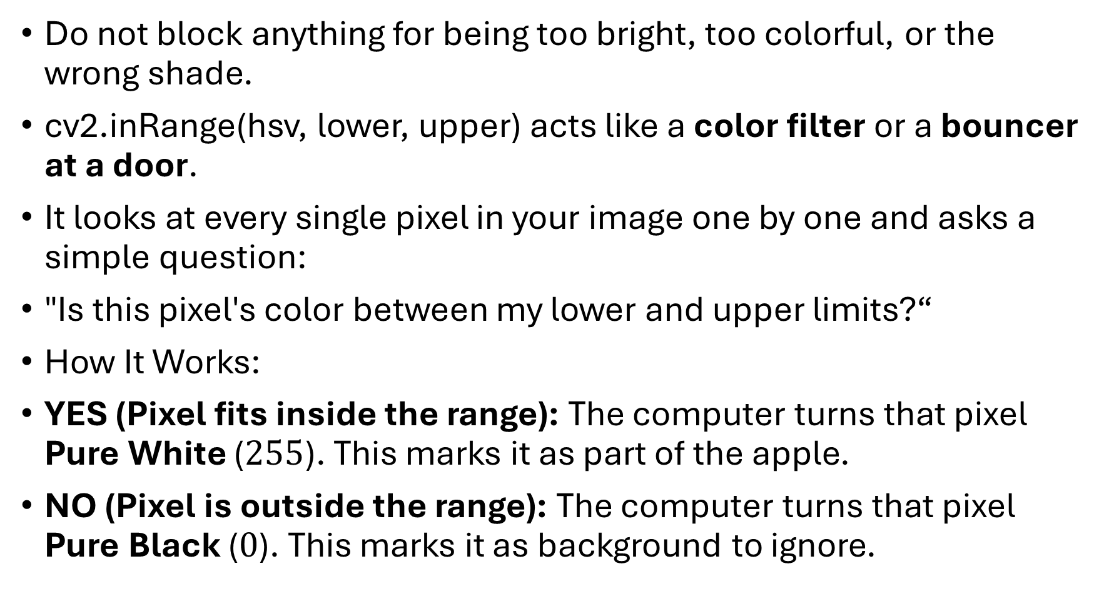
Do not block anything for being too bright, too colorful, or the wrong shade.
cv2.inRange(hsv, lower, upper) acts like a color filter or a bouncer at a door.
It looks at every single pixel in your image one by one and asks a simple question:
"Is this pixel's color between my lower and upper limits?“
How It Works:
YES (Pixel fits inside the range): The computer turns that pixel Pure White ($255$). This marks it as part of the apple.
NO (Pixel is outside the range): The computer turns that pixel Pure Black ($0$). This marks it as background to ignore.

Slide 174
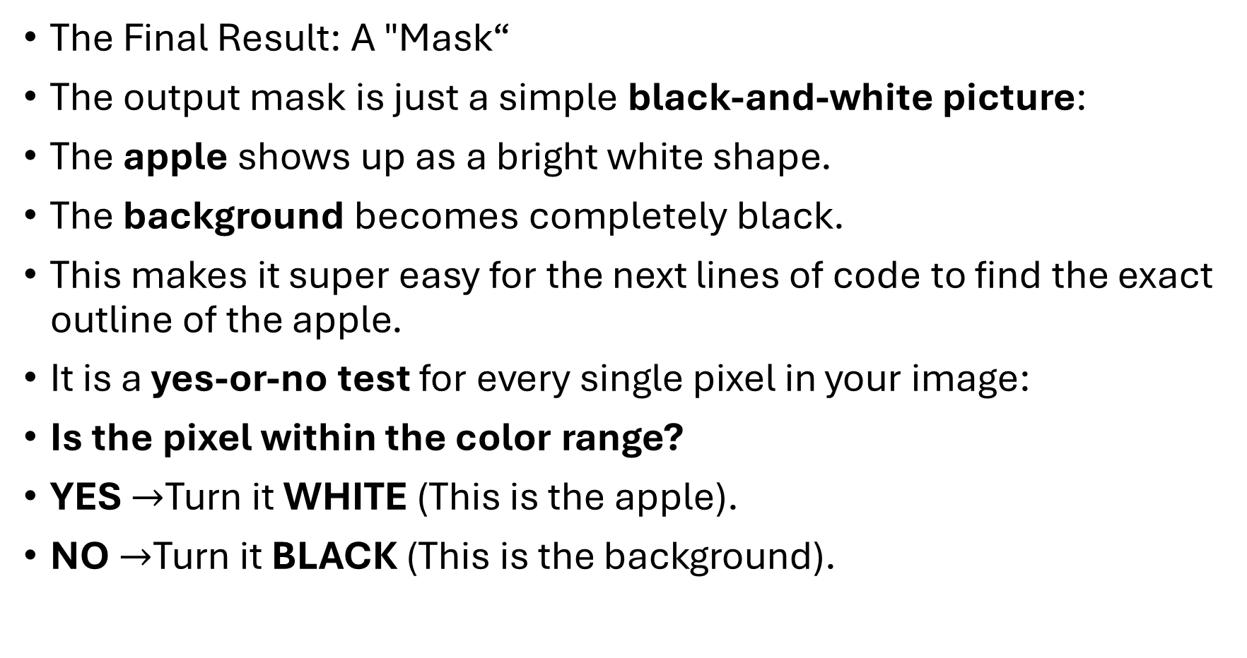
The Final Result: A "Mask“
The output mask is just a simple black-and-white picture:
The apple shows up as a bright white shape.
The background becomes completely black.
This makes it super easy for the next lines of code to find the exact outline of the apple.
It is a yes-or-no test for every single pixel in your image:
Is the pixel within the color range?
YES $→$Turn it WHITE (This is the apple).
NO $→$Turn it BLACK (This is the background).

Slide 175
This creates a tiny 5×5 pixel eraser/paintbrush tool made of all 1s.
The computer slides this small square across the image to clean up messy spots:
It rubs out tiny specks of dust (dots outside the apple).
It fills in tiny holes or gaps (dots inside the apple).
In short: It is the "brush" size used for cleaning up the black-and-white mask.
cv2.RETR_EXTERNAL: Only find the outermost contours

Slide 176
Eg: Imagine a white object with a black hole:
There are two boundaries:
The outer boundary of the object
The inner boundary around the hole
111111111
111000111
110000011
111000111
111111111

Slide 177
Here 1 = object and 0 = background.
What OpenCV does roughly
It scans the image row by row.
When it encounters a transition like:
0 0 0 1 1 1
↑
boundary
it knows:
"I just entered an object. This is an outer boundary."

Slide 178
If later it encounters a boundary inside an already detected object, that's an inner/nested contour:
111111111
111000111
↑
inner boundary
OpenCV can detect that relationship while tracing the boundaries.
So RETR_EXTERNAL basically says:
"If a contour is inside another contour, don't return it. Only return contours that don't have an outer contour containing them."

Slide 179
RETR_EXTERNAL then tells it to keep only the top-level contours.
cv2.CHAIN_APPROX_NONE: "Keep every point along the contour.“
So the contour contains lots of points describing the exact boundary.
if len(contours) == 0: print("No contour found!") exit()
contours contains all the contours OpenCV found.
Len: How many contours did OpenCV find?
If there are 3:len(contours) # 3
"If the number of contours is zero.“
If OpenCV didn't find any object boundary...

Slide 180
cnt = max(contours, key=cv2.contourArea)
"From all the contours, find the one with the largest area and store it in cnt.“
Suppose OpenCV found 3 contours:
contours = [Contour A, Contour B, Contour C]
Area:
A → 100
B → 500
C → 250

Slide 181
A → 100
B → 500 ← largest
C → 250
So it selects Contour B.
key=cv2.contourArea
Don't compare the contours themselves. Compare them based on their area.“
Find the contour with the largest area.

Slide 182
complex_pts = (
cnt[:, 0, 0] +
1j * cnt[:, 0, 1]
)
Your contour must look like
cnt =
[
[[10, 20]],
[[11, 20]],
[[12, 21]],
[[12, 22]]
]

Slide 183
Each point is:
[x, y]
So:
Point 1 → x=10, y=20
Point 2 → x=11, y=20
Point 3 → x=12, y=21

Slide 184
cnt[:, 0, 0]
It extracts all the x coordinates:
cnt[:, 0, 1]
extracts all the y coordinates:
1j?
1j is Python's way of representing the imaginary number.
A complex number looks like:
x + yj
For example:
10 + 20j

Slide 185
cnt[:, 0, 0] + 1j * cnt[:, 0, 1]
combines: x + yj
For our example:
x = [10, 11, 12, 12]
y = [20, 20, 21, 22]
becomes:
[10+20j, 11+20j, 12+21j, 12+22j]

Slide 186
Why do this?
It represents each 2D point (x, y) as one complex number:
This is often useful when doing mathematical operations on the contour, such as Fourier analysis/descriptors.
ake every contour point's x and y coordinates and combine them into complex numbers.“
1j is a special value used to make a complex number.
j = √(-1)
j is there so that X and Y can be represented together as X + Yj.
Imaginary here means a special type of number used when dealing with the square root of negative numbers.

Slide 187
Program 2
Set minimum object size
min_area = 500
object_count = 0
You don't want tiny objects/noise to be counted.
So:
Area < 500 → ignore
Area ≥ 500 → object
object_count starts at 0.

Slide 188
Look at every contour
for cnt in contours:
This means:
"Take each contour one by one."
Calculate the contour's area
How much area does this contour/object cover?
Object 1 → area = 1200
Object 2 → area = 50
Object 3 → area = 800

Slide 189
Ignore small objects
if area < min_area:
continue
Remember: min_area = 500
Area = 50
↓
50 < 500
↓
Ignore it
continue means:
Skip this contour and move to the next one.

Slide 190
Count the object
object_count += 1
First object → 1
Second object → 2
Third object → 3
Find the rectangle around the object
x, y, w, h = cv2.boundingRect(cnt)

Slide 191
You get:
x → left position
y → top position
w → width
h → height
Draw the box
cv2.rectangle(
output,
(x, y),
(x + w, y + h),
(0, 255, 0),
2
)

Slide 192
x = 100
y = 50
w = 200
h = 150
Top-left:
(100, 50)
Bottom-right:
(100 + 200, 50 + 150)
= (300, 200)

Slide 193
So OpenCV draws a rectangle from:
(100, 50) → (300, 200)
Simple meaning: (x,y) tells where the box starts, and (x+w, y+h) tells where the box ends.

